Slide 1
A Survey on Explainability in Machine Reading Comprehension
김주찬

Slide 2
Purpose of this paper
Categorize explanation-supporting benchmarks

Slide 3
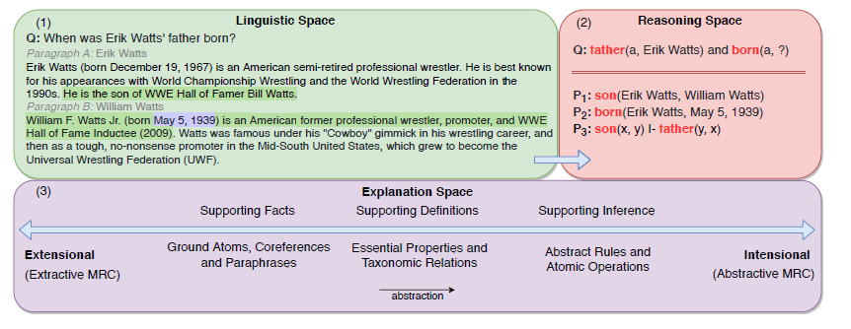
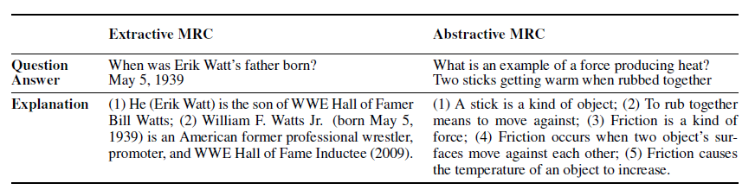
Machine Learning Comprehension
Importance of Explainability
Extractive and Abstractive
Notes:
Extractive : reasoning required to solve the task is derivable from the og problem formulation/correct decomposition of the problem pro
Abstractive: require going beyond the surface form of the problem with the inclusion of high level knowledge about abstract concepts

Slide 4
Explainability in MRC
Scope of Explainability
Knowledge based explanation: Exposing part of background knowledge connecting p and c in terms of sup. Facts and/or inf. rule
Operation explanation: composing a set of atomic operations
KBE emphasizes the problem of explanatory relevance
Identification of relevant information for the construction of explanation
OE emphasizing question decomposition
Casting a problem expressed in natural language into an executable program

Slide 5
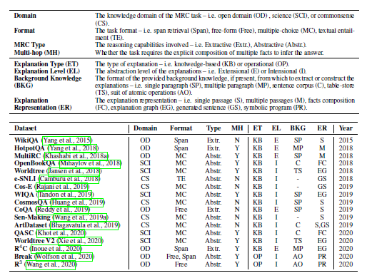
Classify Explanation supporting benchmark
Labelled data for training on explanation
Includes gold justification
Design for quantitative explanation evaluation
Supports the use of quantitative metrics for evaluating the explainability of MRC system
Notes:
이 두조건을 만족하는 데이터셋 만 분류했다

Slide 6
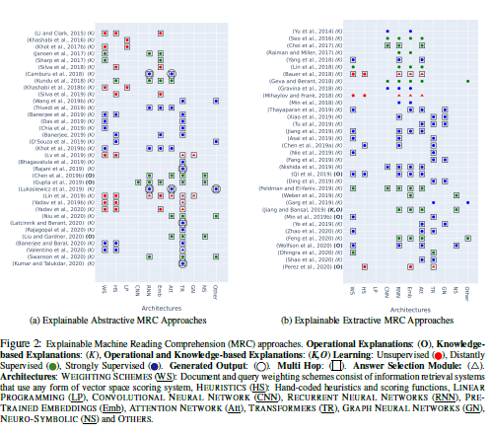
Explainable MRC Architecture
Classified approaches

Slide 7
KBE
Explicit model
Adopt heuristics and hand-crafted constraints to encode high level hypotheses of explanatory relevance
Latent Model
Learn the notion of explanatory relevance implicitly through the use of machine learning techniques
Hybrid model
Adopt heuristics and hand-crafted constraints as a pre-processing step to impose an explicit inductive bias for explanatory relevance

Slide 8
Explicit model
LP
For modeling semantic and structural constraints in an unsupervised fashion
Weight scheme with heuristics
For the implementation of lightweight method that are inherently scalable to large corpora and knowledge base
Pretrained embedding with heuristics
For capturing semantic similarity, going beyond the lexical overlaps limitation imposed by the use of weighting schemes

Slide 9
Latent Model
Neural models for sentence selection
For answer sentence selection problem
Transformers for multi-hop reasoning
To learn explanatory relevance in both extractive and abstractive
Attention networks for multi-hop reasoning
For extracting relevance explanatory facts
Language generation model
Automatically generate semantic plausible & coherent explanation sentences

Slide 10
Hybrid model
Graph Networks
Viable support for reasoning and learning over structured representations.
Explicit inference chains for multi-hop reasoning
Emulate the step-by-step reasoning process involved in multi-hop MRC

Slide 11
Operational Explanation
Aim at providing interpretability by exposing the set of operations adopted to arrive at the final answer.
Neuro-Symbolic models
Combine neural models with symbolic programs.
Multi-hop question decomposition
Aim at breaking multi-hop questions into single-hop queries that are simpler to solve

Slide 12
Evaluation
Silver Explanation
automatically curate silver explanations for training
Evaluating multi-hop reasoning
Evaluating explainability through multi-hop reasoning

